Slide 1
Getting Started with SharePoint Framework Extensions
Introduction to Extensions & Application Customizers

Slide 2

Introduction to Extensions & Application Customizer
SPFx Extensions
Debugging & Testing Extensions
Deploying Extensions
Application Customizers

Slide 3
SharePoint Framework Extensions
Extend the SharePoint user experience
Customize notification areas, toolbars & list data views
Available in Modern pages, lists & libraries
SharePoint Online
SharePoint Server 2019
Used to implement popular customizations from previous development models
Delegate controls & ScriptLink
Client-Side Rendering & JSLink
Custom Actions

Slide 4
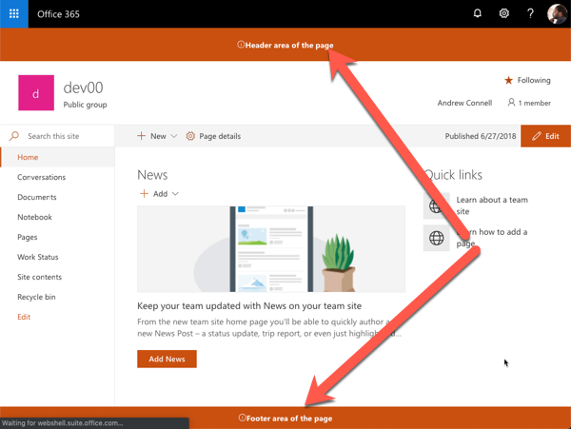
Application Customizers
Add script to any page, header & footer controls

Slide 5
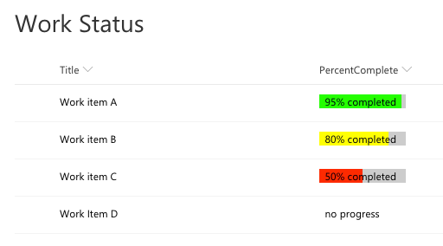
Field Customizers
Customize rendering of a list column in modern lists

Slide 6
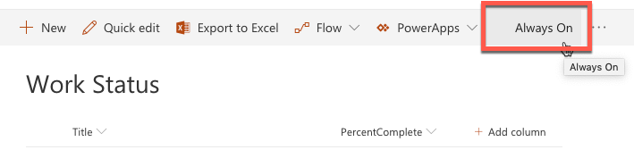
Command Sets
Add buttons to list & library toolbars & context menus

Slide 7
Project Structure
.vscode: includes Visual Studio Code integration files
config: includes all config files
dist: created automatically on builds – contains out from bundle process
lib: created automatically on builds – contains pre-bundled built files
node_modules: created automatically when installing all package dependencies with a package manager
sharepoint: contains assets needed for deployment
src: this is the main folder of the project, it includes the extension, styles, and a test file
temp: created automatically on builds - contains local dev webserver files

Slide 8
Debugging & Testing Extensions
Unlike web parts, extensions require a live SharePoint site, list and/or library
Can still build and host extension project locally while testing in a remote SharePoint site
Similar experience to using hosted SharePoint workbench for web part development, testing & debugging
Configurations added to each project by the SPFx Yeoman generator simplifying loading SharePoint sites
Instructs SharePoint to load SPFx & manifest file from https://localhost

Slide 9
Deployment
Extension deployment utilizes existing Feature framework
Application customizer: <CustomAction>
Field customizer: <Field>
Command set: <CustomAction>
Deployment similar to web parts
Upload SharePoint Package to tenant | site collection app catalog
Install app
Some extensions type support tenant-wide deployment

Slide 10
Tenant Wide Deployment
Centralized control of which extensions are available across entire tenant
Consistent end-user experience across all sites
Consistent deployment across all sites
Automatically enable functionality on newly created sites

Slide 11
Tenant Wide Deployment
Automatically deploy extension to all sites in a SharePoint Online tenant
Bypasses need for installation in each site collection
Supported for application customizers & list view command sets
Make available for specific web or list templates
Specify public properties on extension across all sites
Default experience by presence of ClientSideInstances.xml in *.sppkg
Delete this file if tenant wide deployment not desired

Slide 12
List: Tenant Wide Extensions
Control tenant wide deployments with this app catalog list
Column | Type | Description
Title | string | Title of the entry. Can be descriptive entry for the registration. Doesn’t have to match anything, just for your reference
Component ID | GUID | Manifest ID of the component. Has to be in GUID format and component must exists in the app catalog.
Component Properties | string | Optional component properties.
Web Template | string | Can be used to target extension only to specific web template.
List Template | int | List type as a number.
Location | string | Location of the entry. There are different support locations for application customizers and List View Command Sets.
Sequence | int | Sequence of the entry in rendering.
Disabled | Boolean | Enabled state of the deployment.

Slide 13
Application Customizers
Add HTML or JavaScript to all pages in a SharePoint site
Similar to pre-SPFx / classic mode customizations
Delegate control
ScriptLink control
Example scenarios
Add script to every page
Add 3rd party libraries to every page (ie: Azure Application Insights)
Add notice to all pages such as: alerts, news or privacy

Slide 14
Application Customizer - Placeholders
Two well-known placeholders exist on all pages
Header (just below Office 365 suite bar)
Footer (bottom of page)
Placeholders are sticky & always visible

Slide 15
Application Customer
export interface IHelloAppCustomizerApplicationCustomizerProperties {
prefixString: string;
}
export default class HelloAppCustomizerApplicationCustomizer
extends BaseApplicationCustomizer<IHelloAppCustomizerApplicationCustomizerProperties> {
private _topPlaceholder: PlaceholderContent | undefined;
private _bottomPlaceholder: PlaceholderContent | undefined;
@override
public onInit(): Promise<void> {
// this is where you do your work
}
private _onDispose(): void {
}
}

Slide 16
Demo Creating SharePoint Framework Application Customizers

Slide 17

Summary
SPFx Extensions
Debugging & Testing Extensions
Deploying Extensions
Application Customizers

Slide 18
Reading further
Overview of the SharePoint Framework
https://docs.microsoft.com/sharepoint/dev/spfx/sharepoint-framework-overview
Overview of SharePoint Framework Extensions
https://docs.microsoft.com/sharepoint/dev/spfx/extensions/overview-extensions
Use Page Placeholders from Application Customizer
https://docs.microsoft.com/sharepoint/dev/spfx/extensions/get-started/using-page-placeholder-with-extensions
Tenant Wide Deployment of SharePoint Framework Extensions
https://docs.microsoft.com/sharepoint/dev/spfx/extensions/basics/tenant-wide-deployment-extensions

Slide 19
Thank you.

